Slide 1
Permutations and Combinations

Slide 2
Counting
Counting problems would require an answer to a question beginning with how many – but without listing all solutions.
How many numbers can we write using 3 digits ?
How many different plate numbers can one have if 7 alphanumeric symbols are allowed?
How many odd integers are there from 10 through 99 have distinct digits?
How many different 8-letter passwords are there if only letters are accepted?

Slide 3
Basic Counting Principles - 1
Example: How many numbers can we write using 3 digits?
Solution:
There are 10 possibilities to select the first digit (that is from 0 to 9), then we have 10 ways of selecting the second digit and another 10 possibilities for selecting the third digit:
So there are 10×10×10= 1000 different numbers.
As you may have guessed: those are the numbers from 0 to 999: worth noting that we did not have to list them!

Slide 4
Basic Counting Principles - 2
Example: One would want to flip a coin and roll a dice
Tossing a coin has two outcomes (head / tail)
And there are 6 outcomes for rolling a dice.
So: one can see there are 12 ways for flipping a coin and rolling a dice!

Slide 5
From counting to probabilities - 1
As we have seen in the previous example: there 12 possible ways or outcomes
What is then the probability of having ‘tail’ and ‘1’?
We can call this particular outcome an event: then you can see it is an event occurrence out of 12 possible outcomes
probability (coin toss = tail and dice roll = 1) = 1/12

Slide 6
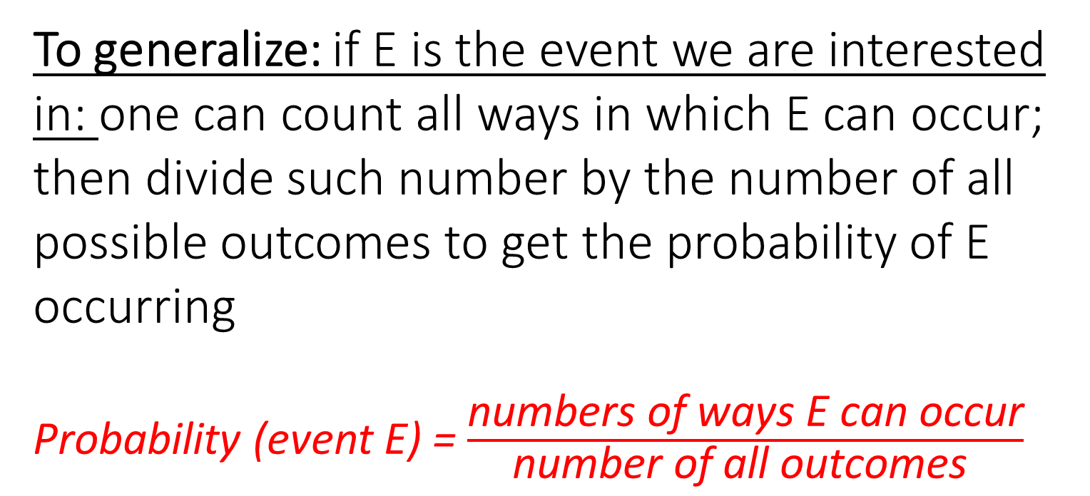
From counting to probabilities - 2
To generalize: if E is the event we are interested in: one can count all ways in which E can occur; then divide such number by the number of all possible outcomes to get the probability of E occurring
Probability (event E) = $\frac{\text{numbers} \text{of} \text{ways} \text{E} \text{can} \text{occur}}{\text{number} \text{of} \text{all} \text{outcomes} }$

Slide 7
From counting to probabilities - 3
Back to coin tossing: flipping the coin three times (we have only one coin) what is the probability of having ‘tail’ each time? Can you see it is 1/8
Now the coin is being flipped 10 times: what is the probability of not seeing a single ‘head’?
How do we solve the coin problem? Flip it around (Get it? Get it?)

Slide 8
Permutations -1
Permutation: the number of ways in which we can arrange objects without repetition, and with the order being important (the order being important: think about the order in the lottery!).
Example: three people (A, B and C) are racing; what should be the outcome of the race?
For instance: ‘A’ can come first; but if so ‘A’ can neither be second nor third! (you may see now why considerations should be given to ‘no repetition’); and so on: so we have the following and possible arrangements: ABC, ACB, BAC, BCA, CAB, CBA
For order importance: think about this – first gets gold, second gets silver and third gets bronze!
Notes:
In the general literature you may find that repetitions may be allowed: we have seen an example of the sort in the slide “Basic Counting Principles – 1” – this leads to exponentiation

Slide 9
Permutations - 2
From the previous example of the race involving A, B and C: do you see how many possible arrangements? All 6 of them were listed!
You should note that 6 = 3! = 3×2×1
The factorial function (symbol: !) means to multiply a series of descending natural numbers
Can we list all possible arrangements of ordering all 6 coloured snooker balls? Black yellow blue etc?
It is 6! = 6×5×4×3×2×1 = 720

Slide 10
Permutations - 3
Building on the previous example of snooker’s coloured balls: we shall look at the case when one would only select two balls (but no all 6): 6×5.
There are 6 ways of choosing the first ball; then 5 ways to select the second.
This is equal to 6!/4!
Remember: no repetitions and order matters: black followed by green is not the same as green followed by black

Slide 11
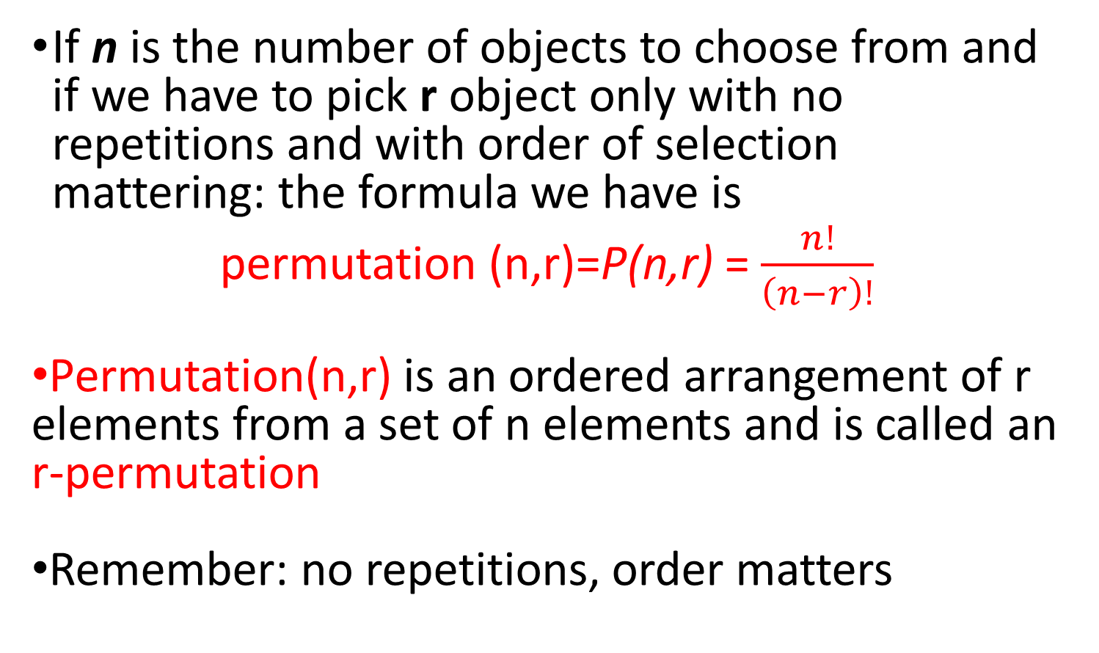
Permutations - 4
If n is the number of objects to choose from and if we have to pick r object only with no repetitions and with order of selection mattering: the formula we have is
permutation (n,r)=P(n,r) = $\frac{n!}{\left(n−r\right)!}$
Permutation(n,r) is an ordered arrangement of r elements from a set of n elements and is called an r-permutation
Remember: no repetitions, order matters

Slide 12
Combinations - 1
Now: order does not matter – we may have to omit repetitions – see example below
Example: How many ways are there to pick a set of 2 people from a group of 6?
One is tempted to think about the problem in the following terms: There are 6 choices for the first person, 5 for the second one which yields 6×5 = 30 possible selections.
With a careful examination: one can admit this is not true!
For example, picking person A, then person B is exactly the same as picking B and then A: this calls for excluding repeated answers!

Slide 13
Combinations - 2
For combinations: order does not matter – we may have to omit repetitions (here: do not take the word “combination” for its vague meaning in the English language ☺ )
Knowing this, we can rework our answer to the question as follows:
How many ways are there to pick a set of 2 people from a group of 6 (taking into account the order of picking )? This is 6!/4! = 30
How many possible repetitions are there if order is not important in picking a set of 2 people ? This is 2! = 2
How many ways are there to pick a set of 2 people from a group of 6 (with disregarding the order of picking)? This is 6!/(4!×2!) = 15
The division by 2! is necessary to omit repetitions

Slide 14
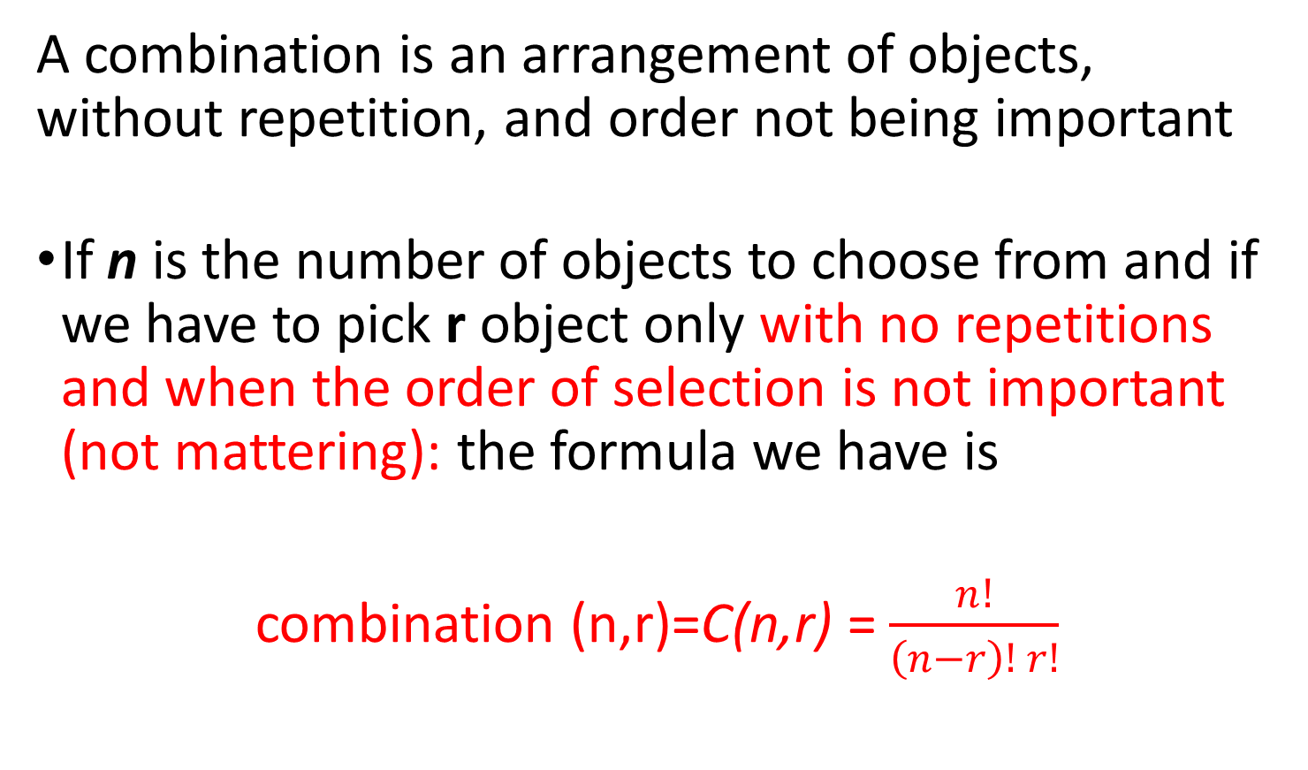
Combinations - 3
A combination is an arrangement of objects, without repetition, and order not being important
If n is the number of objects to choose from and if we have to pick r object only with no repetitions and when the order of selection is not important (not mattering): the formula we have is
combination (n,r)=C(n,r) = $\frac{n!}{\left(n−r\right)! r!}$

Slide 15
Combinations - 4
With 23 people, how many pairs can we have? (obviously one cannot pair up with himself / herself) Can you establish it is 253 pairs

